Slide 1

Balanced scorecard slide 1
VIRTUAL KEYBAORD
Using OpenCV and Python
2019-20

Slide 2
Group Members-
Name E.NO
Himanshu Khairajani (17100017)
Saurabh Pandey (17100049)
Saurabh Roy (17100050)

Slide 3
Guided by :-
Dr. Muneendra Ojha
Assistant Professor
IIITNR

Slide 4
Objective of the Project
The major objectives is to design a vision based Virtual Keyboard which detects interrupt as key recognition. Mono-vision video of hand posture for pressing the keys is analysed. The analysed hand posture is taken into account under various transactions to estimate the key pressed. Mechanical transducers does two operations for key estimation (key press and key release concepts), while Virtual Keyboard requires only key press operation to estimate the key and not key release operation.

Slide 5
Aim
Creating a software environment that allows us to give the input characters without the need of any physical keyboard.

Slide 6
Motivation
Integration of such virtual keyboard with personal computers using serial bus communication could help us to cut down the need for external mechanical keys and keyboards hence decreasing the cost, space complexity and also make PC’s more slimmer and optimal.

Slide 7
Current Technology
Mechanical Keyboard
Touch keyboard

Slide 8



Modules used
OpenCV
Playsound
Spyder IDE
Pyautogui

Slide 9
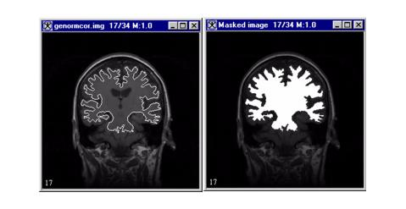
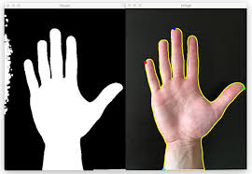

Tools Used
Masking
Contour detection
Convex Hull

Slide 10
FLOWCHART

Slide 11
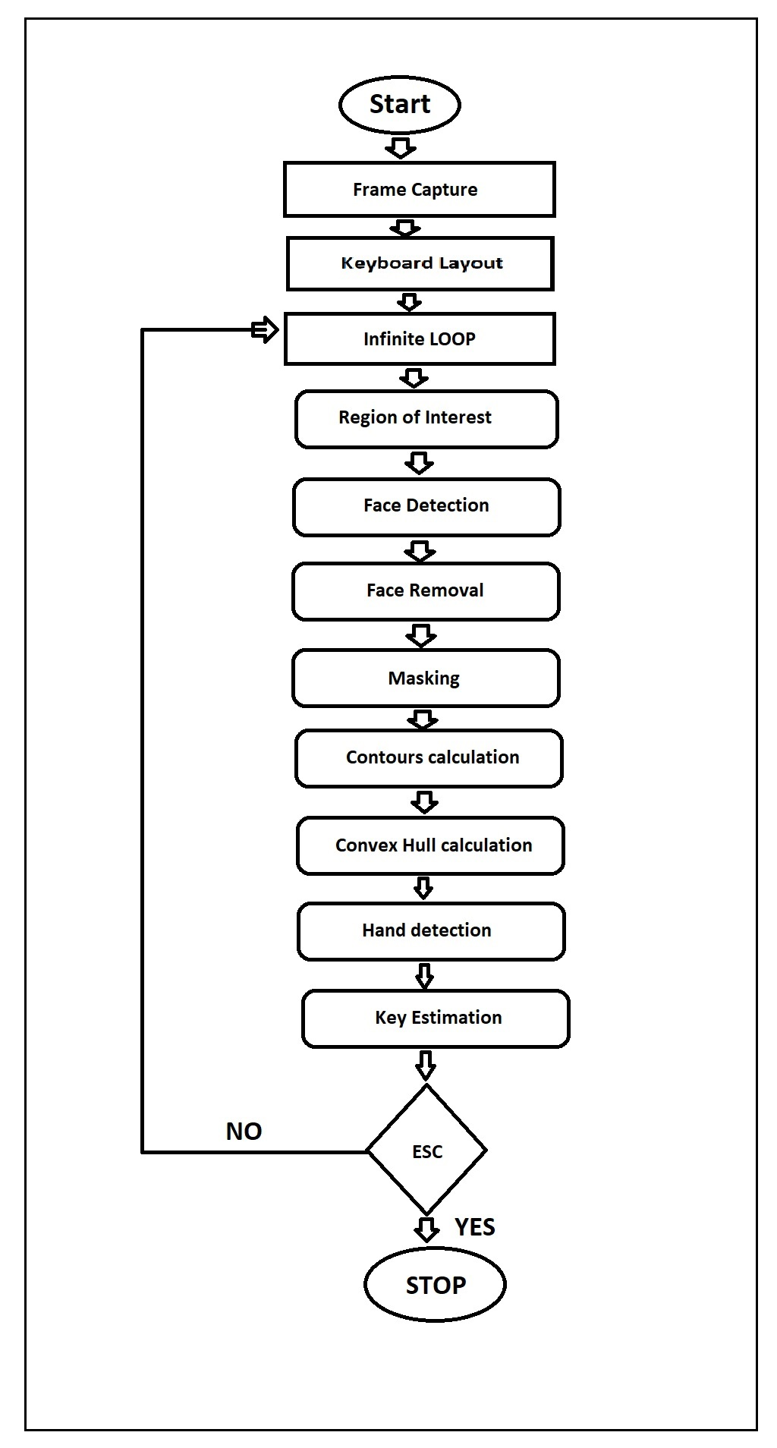

Slide 12
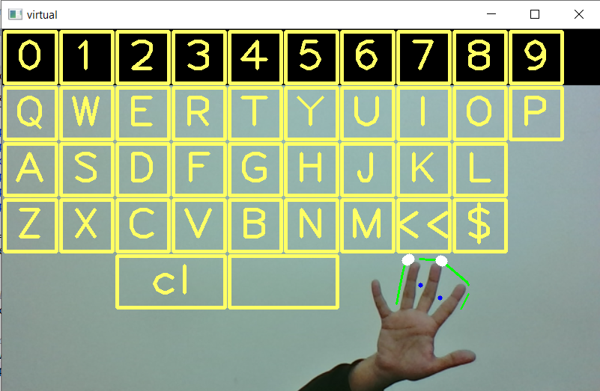
virtual keyboard layout

Slide 13


Masking

Slide 14
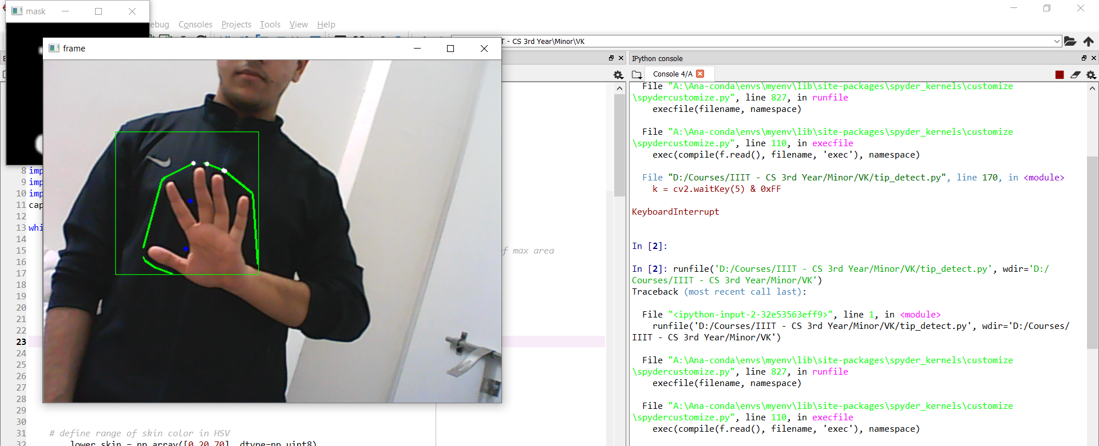
Hand Detection

Slide 15
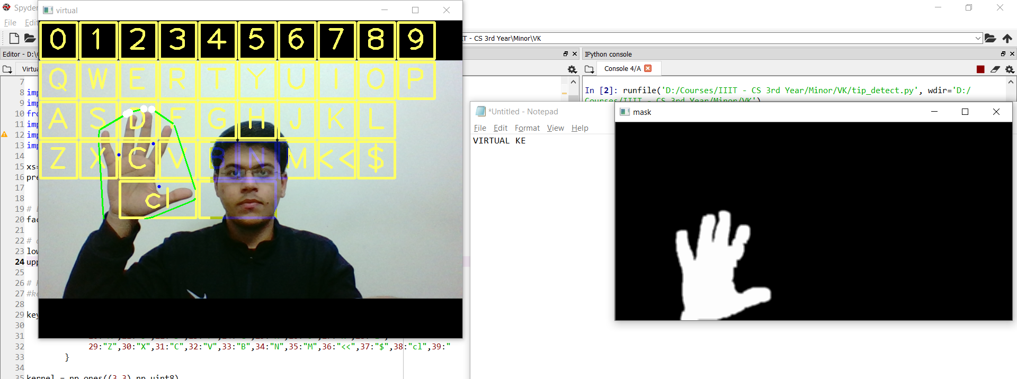
Face detection and removal

Slide 16
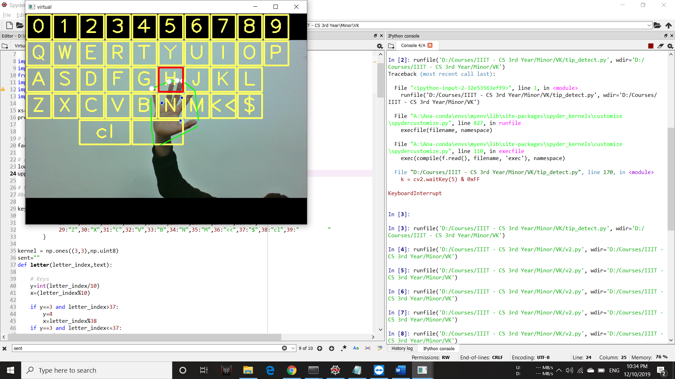
Integration of hand to virtual keyboard

Slide 17
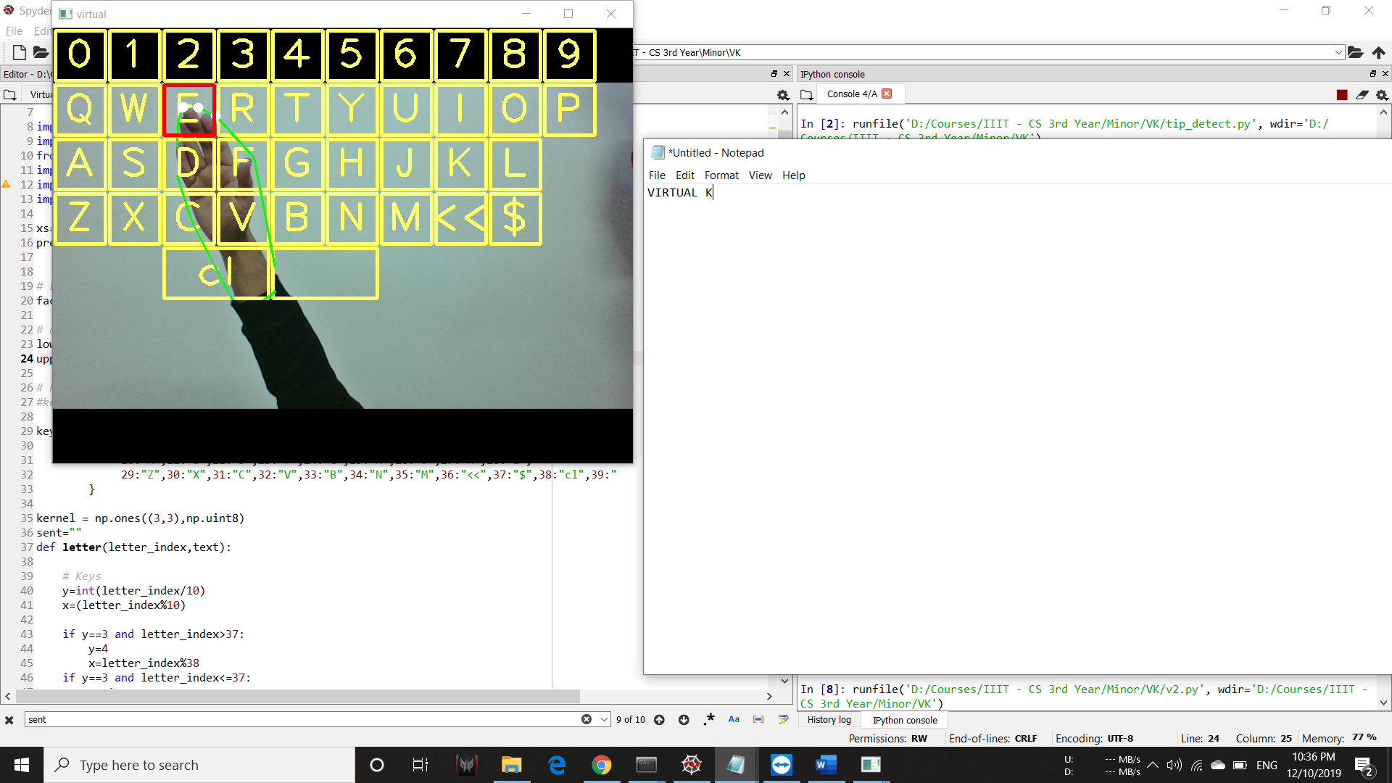
Mapping output to I/O Screen

Slide 18
System live at work

Slide 19
Limitation
Webcam quality
Flickering due to uneven brightness
Background Conflict
Face Orientation

Slide 20
REFERENCES
Youtube.com (video related to OpenCV for object detection using image segmentation.)
https://pysource.com/ (learn how to make keyboard layout.)
https://opencv.org (learn contour extraction of specified object.)
Kolsch, M. and Turk, M.”Keyboards without Keyboards: A survey of Virtual Keyboards,” n. pag.University of California, Nov. 05, 2003 (http://www.create.ucsb.edu/sims/PDFs/Koelsch_and_Turk_SIMS.pdf).

Slide 21
Balanced scorecard slide 10
THANK YOU

